Slide 1
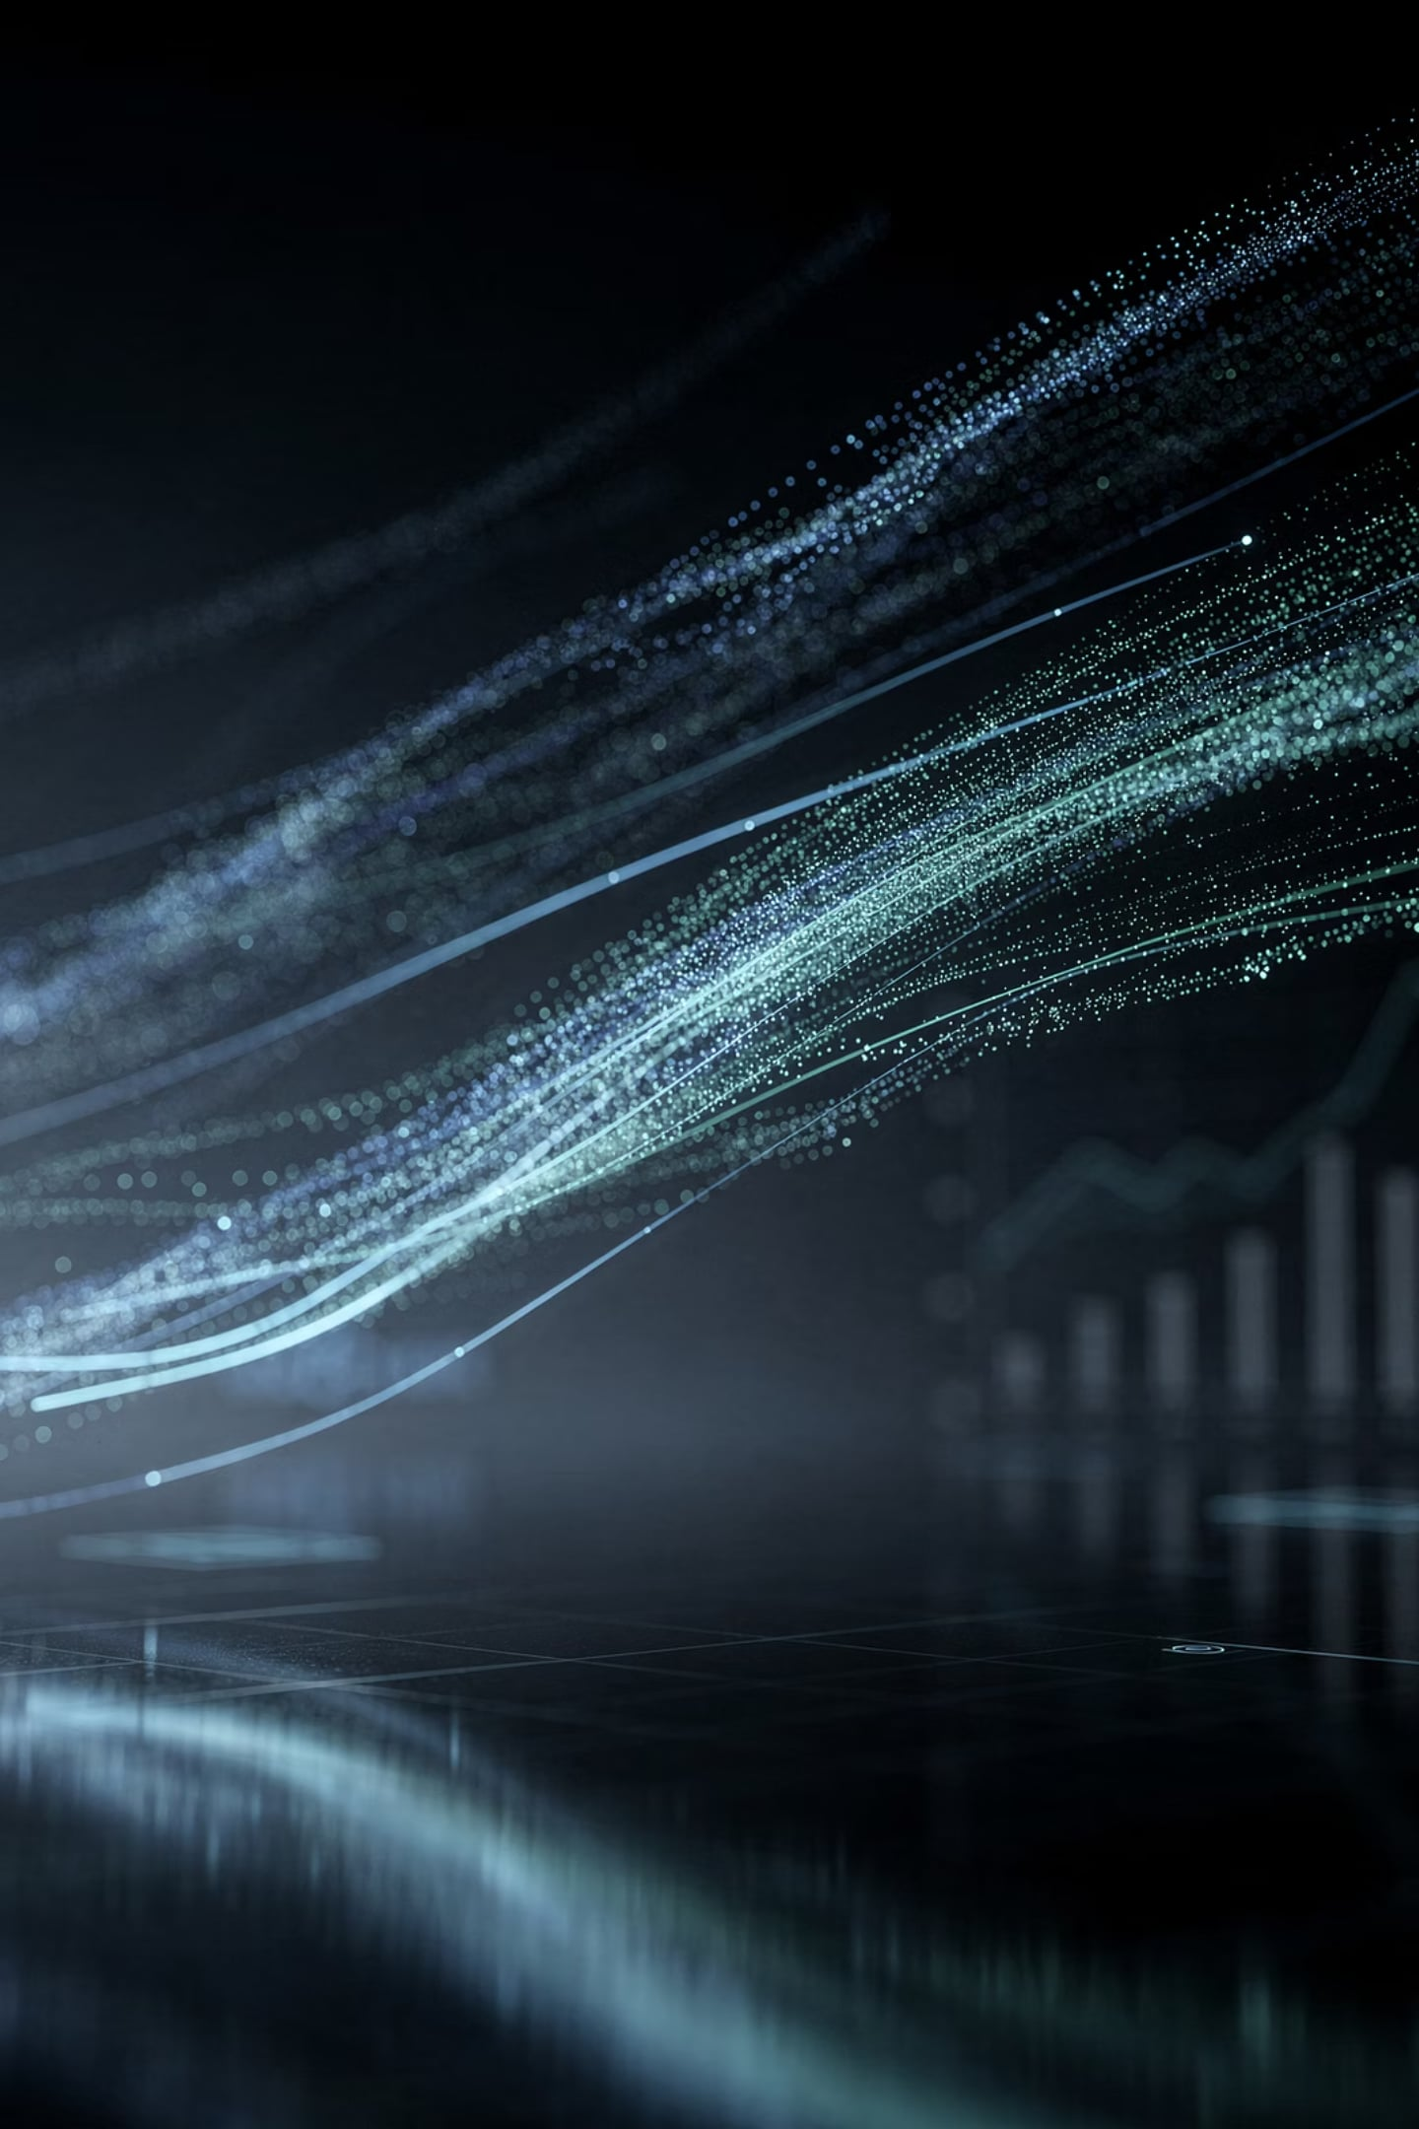

Team 123 International Presents
Expert-Led Automated Trading: The New Standard
How 33Circle fuses veteran market expertise with institutional-grade automation — delivering precision, discipline, and scale.

Slide 2
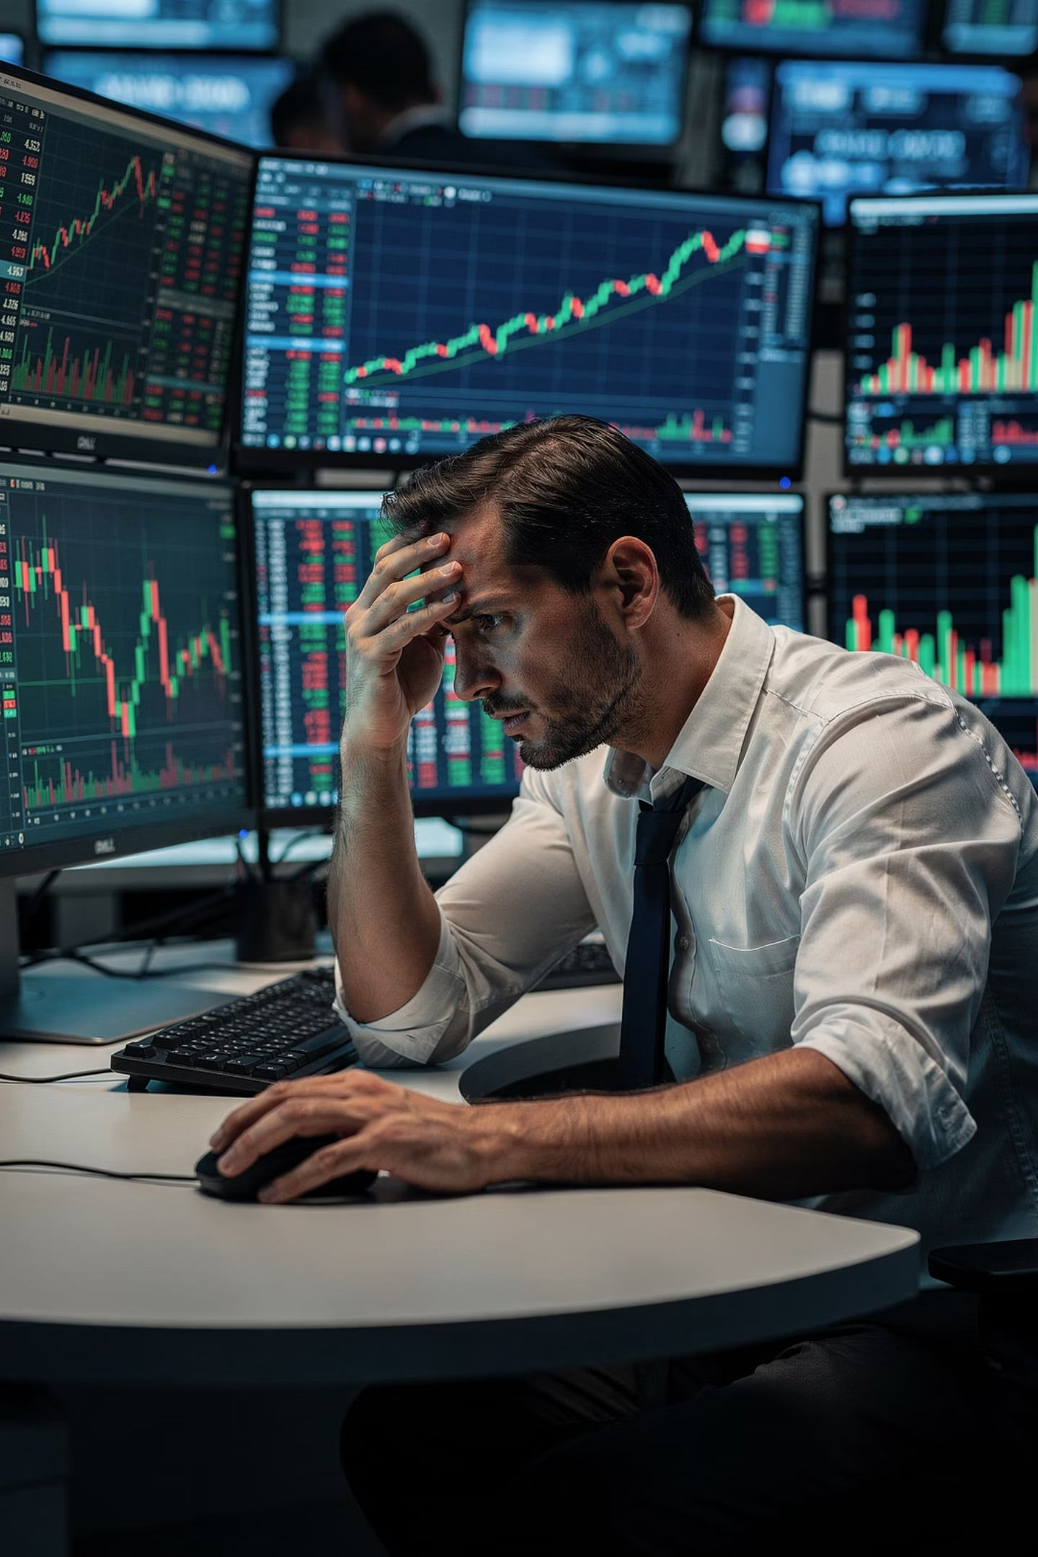
The Manual Trading Trap
Emotion Over Logic
Emotional volatility compromises up to 90% of retail trading decisions — turning strategy into impulse.
Speed Deficit
Human reaction time simply cannot compete in millisecond-latency markets where fortunes are made in microseconds.
Cognitive Fatigue
High-stakes environments create cognitive overload, leading to systematic errors precisely when precision matters most.

Slide 3
The Rise of the Machine
Algorithmic trading didn't emerge overnight — it was built on decades of pioneering innovation by bold market thinkers.
1949
1
Richard Donchian pioneers early quantitative models, laying the groundwork for systematic trend-following.
2
1980s
John Henry legitimizes trend-following systems at institutional scale, proving machines can rival human discretion.
1990s
3
Broader Market Access brings algorithmic execution to a wider audience, democratizing quantitative strategy.
4
Today
Over 70% of all equity volume is algorithmically executed — manual traders are competing against machines.

Slide 4
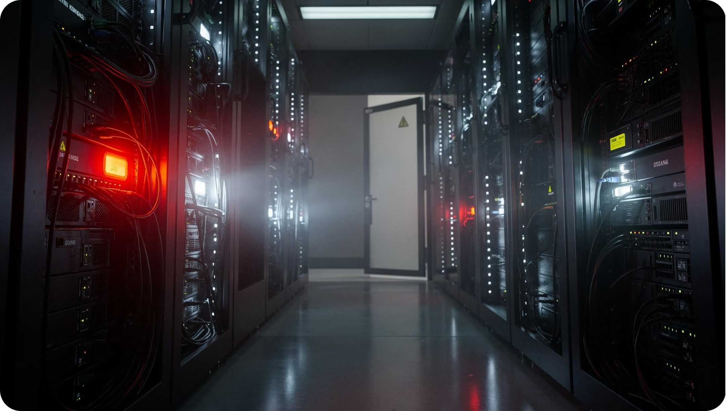
THE GAP
The Missing Link: Where Automation Stalls
Black-Box Blindness
Purely algorithmic systems lack the nuanced intuition that veteran traders build over decades of live market experience.
Flash Crash Risk
Market anomalies and liquidity crises demand human oversight — unchecked automation can amplify disaster.
Static Code, Dynamic Markets
Rigid algorithms fail to adapt to black swan events or shifting macroeconomic regimes in real time.

Slide 5
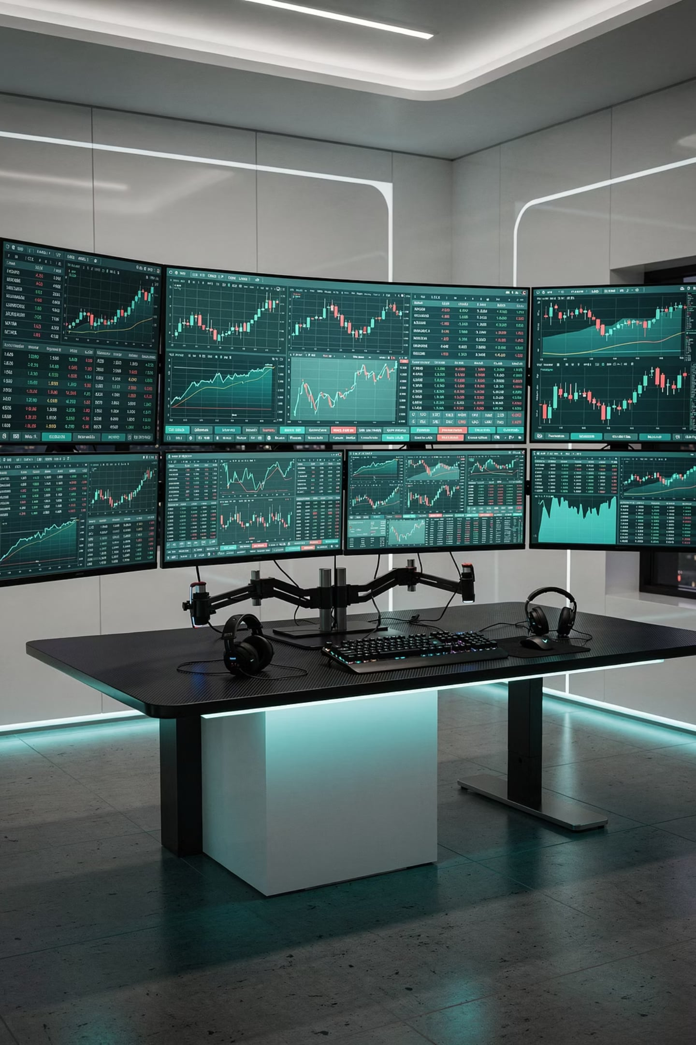
Introducing 33Circle: The Expert-Led Edge
Domain + Execution
Built by Traders
Marrying deep market expertise with high-frequency execution architecture for a decisive competitive edge.
Proprietary systems designed by veteran traders first — not just engineers — ensuring real-world market logic at the core.
Disciplined Science
Precision tools that treat trading as a repeatable, disciplined science — removing guesswork from every decision.

Slide 6
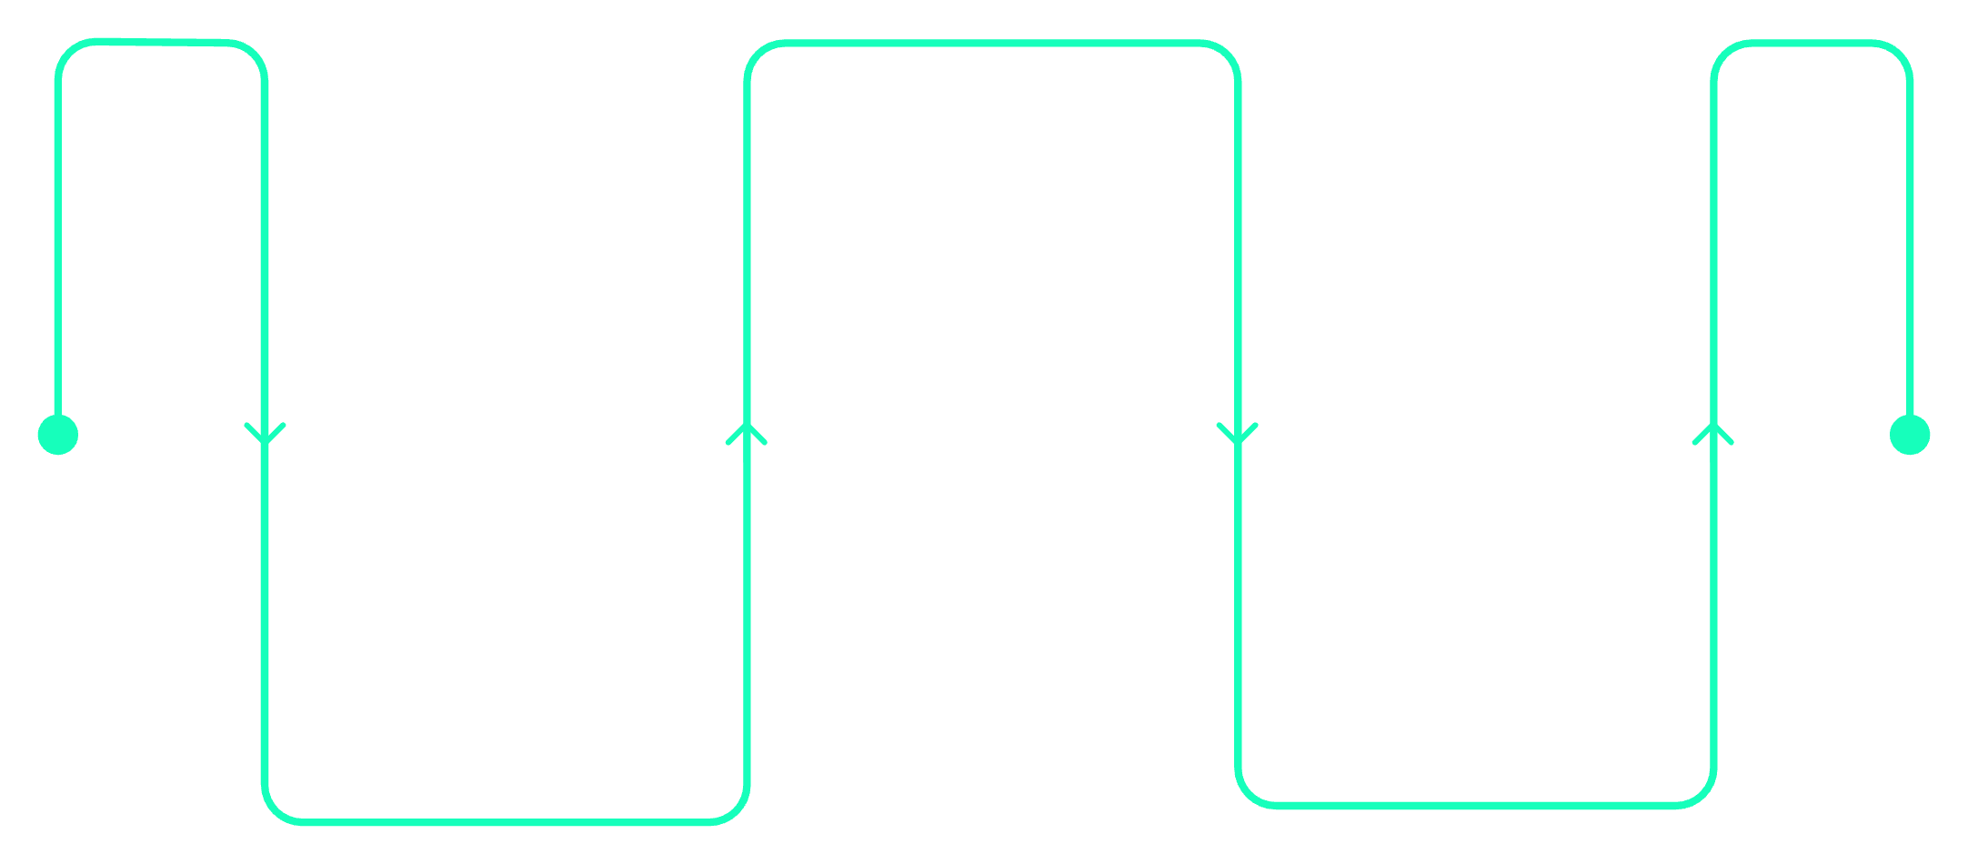
How 33Circle Transforms Strategy
Dynamic Rules Engine
Expert intuition is codified into responsive trading logic that evolves with market conditions.
Backtest at Speed
Validate across markets and time
Execute Without Emotion
Rapid Backtesting
Codify Intuition
Validate strategies against rich historical and real-time datasets before a single dollar is deployed.
Turn expert rules into algorithms
Automate precise, disciplined trades
Emotion-Free Execution
33Circle converts years of hard-won expertise into systematic, rules-based strategies that execute with machine precision and zero emotional interference.
Systematic logic eliminates the biological impulse to panic, hesitate, or overtrade under pressure.

Slide 7
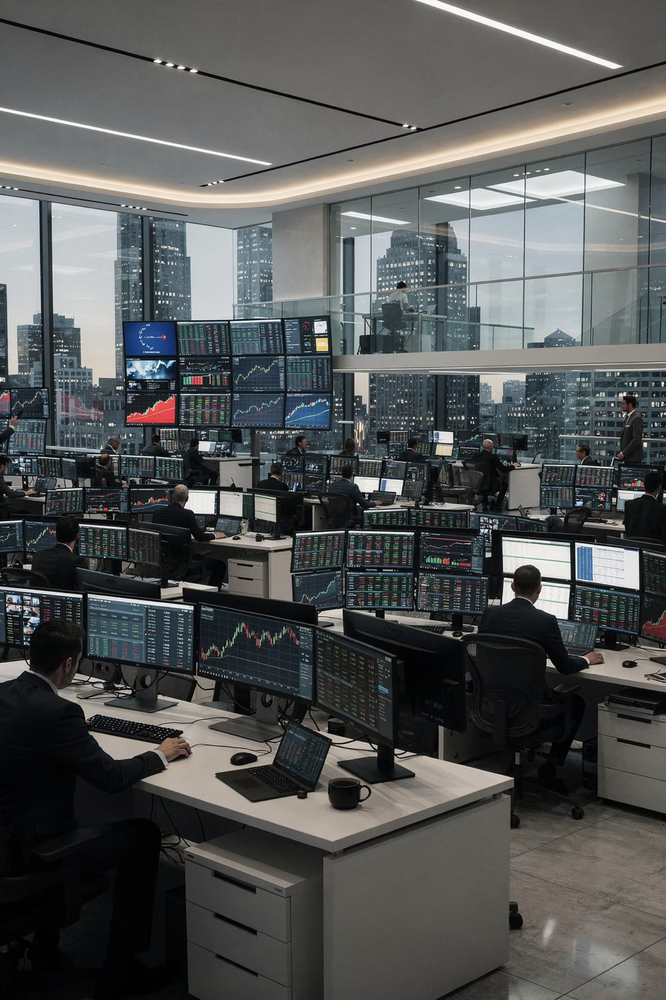
Performance at Scale
Institutional Infrastructure
Human-in-the-Loop
Real-time monitoring of automated flows with expert oversight safeguards against unexpected market dislocations.
Enterprise-grade systems made accessible to the modern sophisticated trader — without the enterprise price tag.
Immutable Risk Logic
Consistent, rule-enforced risk management — every time, every trade, without exception or emotional override.

Slide 8
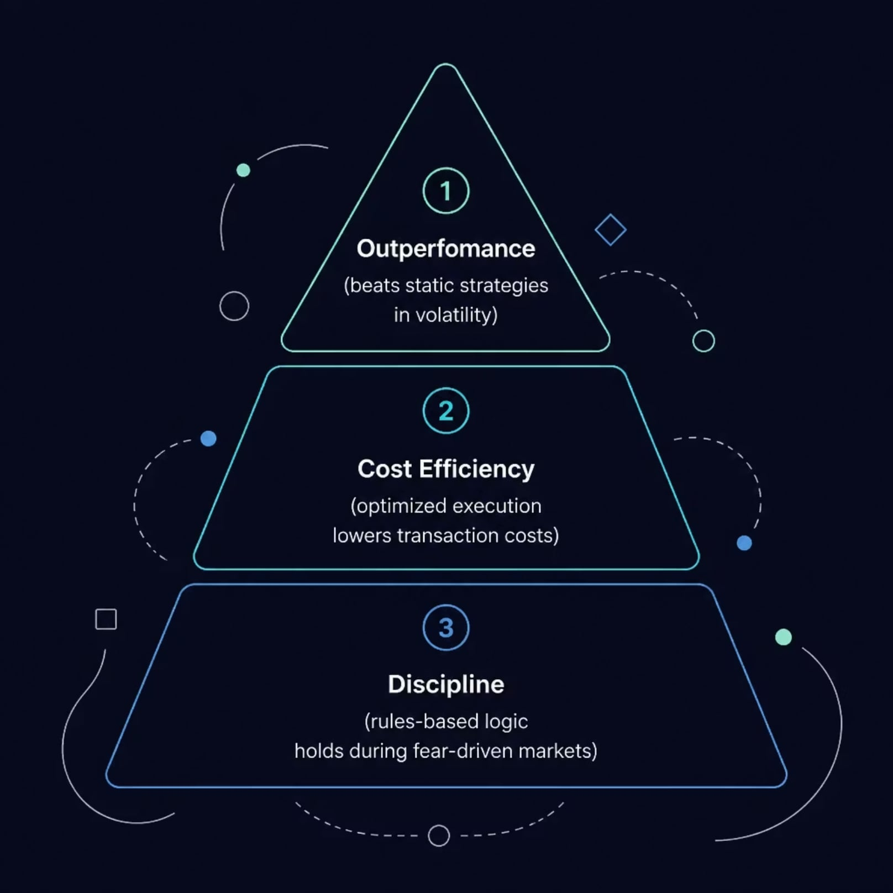
Proven Results in Volatile Markets
When markets panic, 33Circle holds the line. Our systems are stress-tested precisely for the moments that matter most.
Outperforms static strategies during turbulent market conditions when rigid algorithms break down
Reduces transaction costs through optimized, intelligent execution pathways and routing logic
Maintains discipline when fear-driven participants flood the market with irrational orders

Slide 9
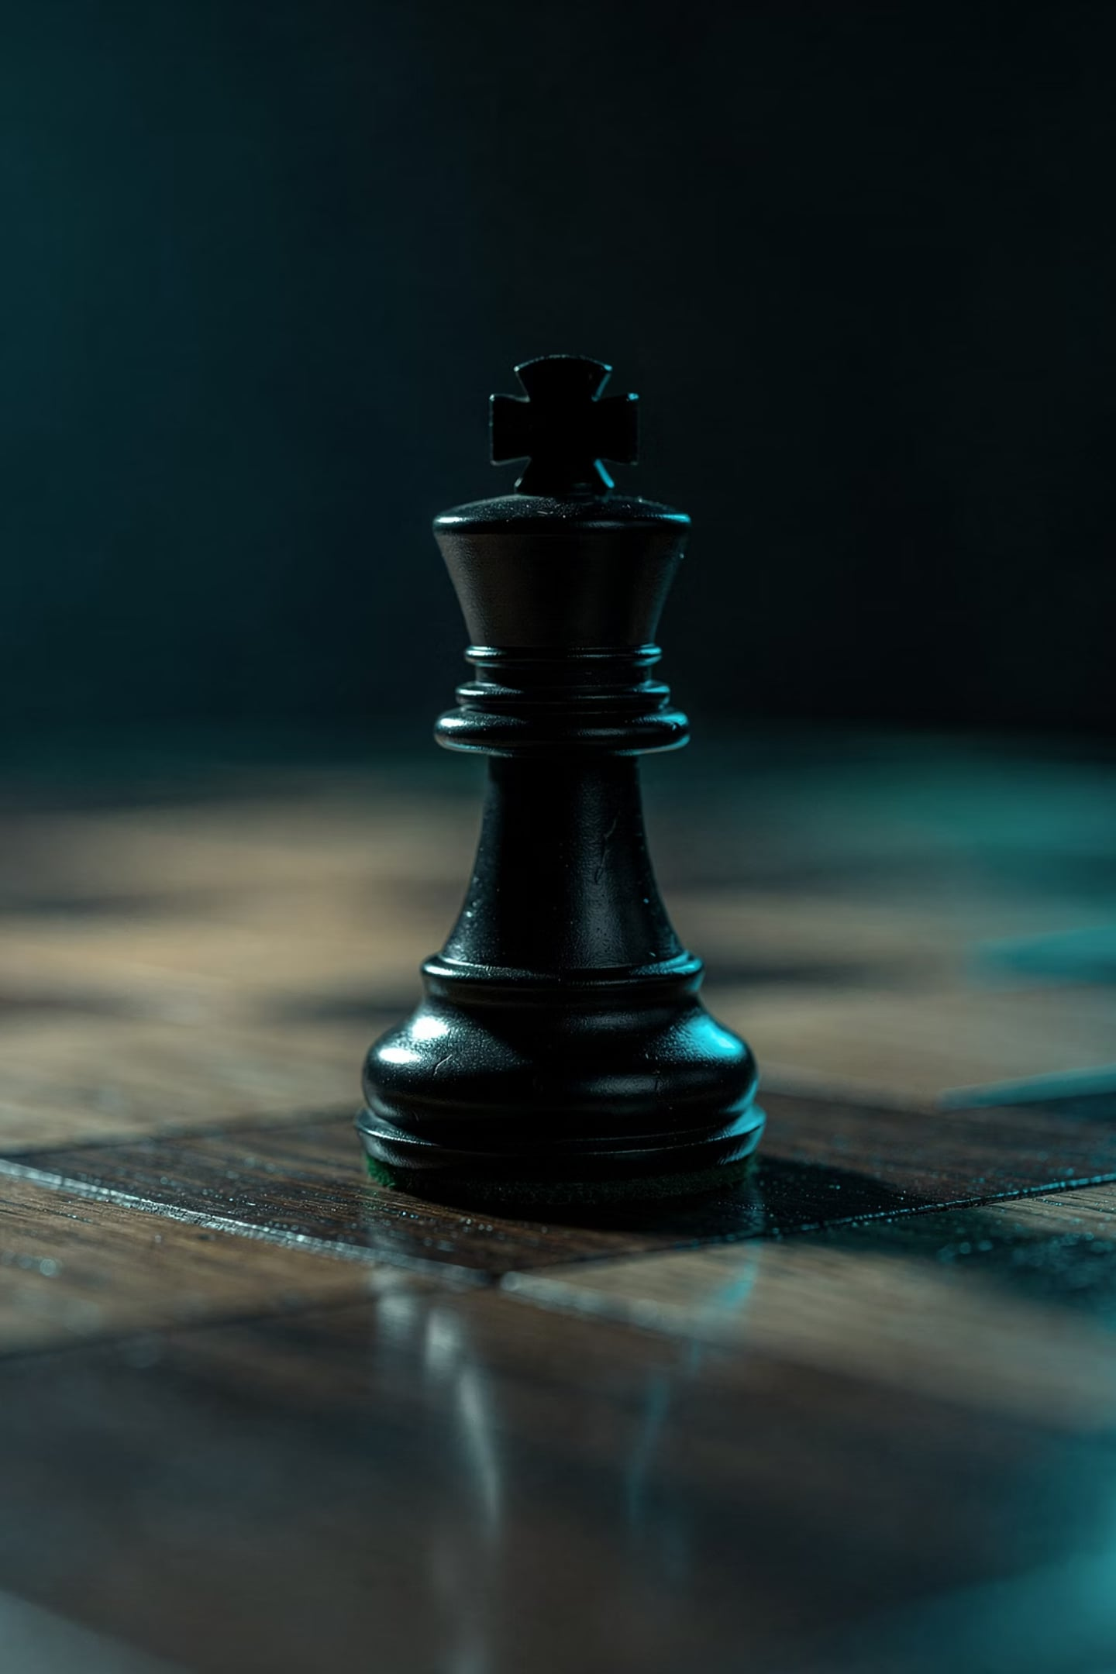
Your Competitive Advantage
The market has already automated. The question is whether you are on the right side of that divide.
Stop Fighting Algorithms
Manual effort against machine execution is a losing battle. Deploy your expertise through 33Circle instead of against it.
Deploy at Market Speed
Use 33Circle to execute your strategic edge at the velocity of modern markets — not the speed of human reaction.
Focus on What Matters
Redirect your attention from screen-watching to high-value capital allocation and strategic decision-making.

Slide 10

Join the 33Circle Evolution
The next era of financial markets belongs to those who combine human expertise with machine precision. Your transition starts now.
01
02
Transition
Integrate
Move from manual execution to expert-led automated precision with full strategic continuity.
Schedule your custom integration strategy session and map your expertise into the 33Circle framework.
03
Dominate
Secure your edge in the next era of financial markets — before your competition does.
Ready to evolve? Watch the Video for an overview of 33Circle to begin your strategy session and claim your position at the forefront of expert-led automated trading.

Slide 11
Stay Blessed

